Slide 1
Charlie (year 7), Jimmy (year 8),
Chloe (year 8),
Keeley (year 8),
Elise (year 8),
Sharna (year 11), Matthew (age 18), George (age 18)

Slide 2
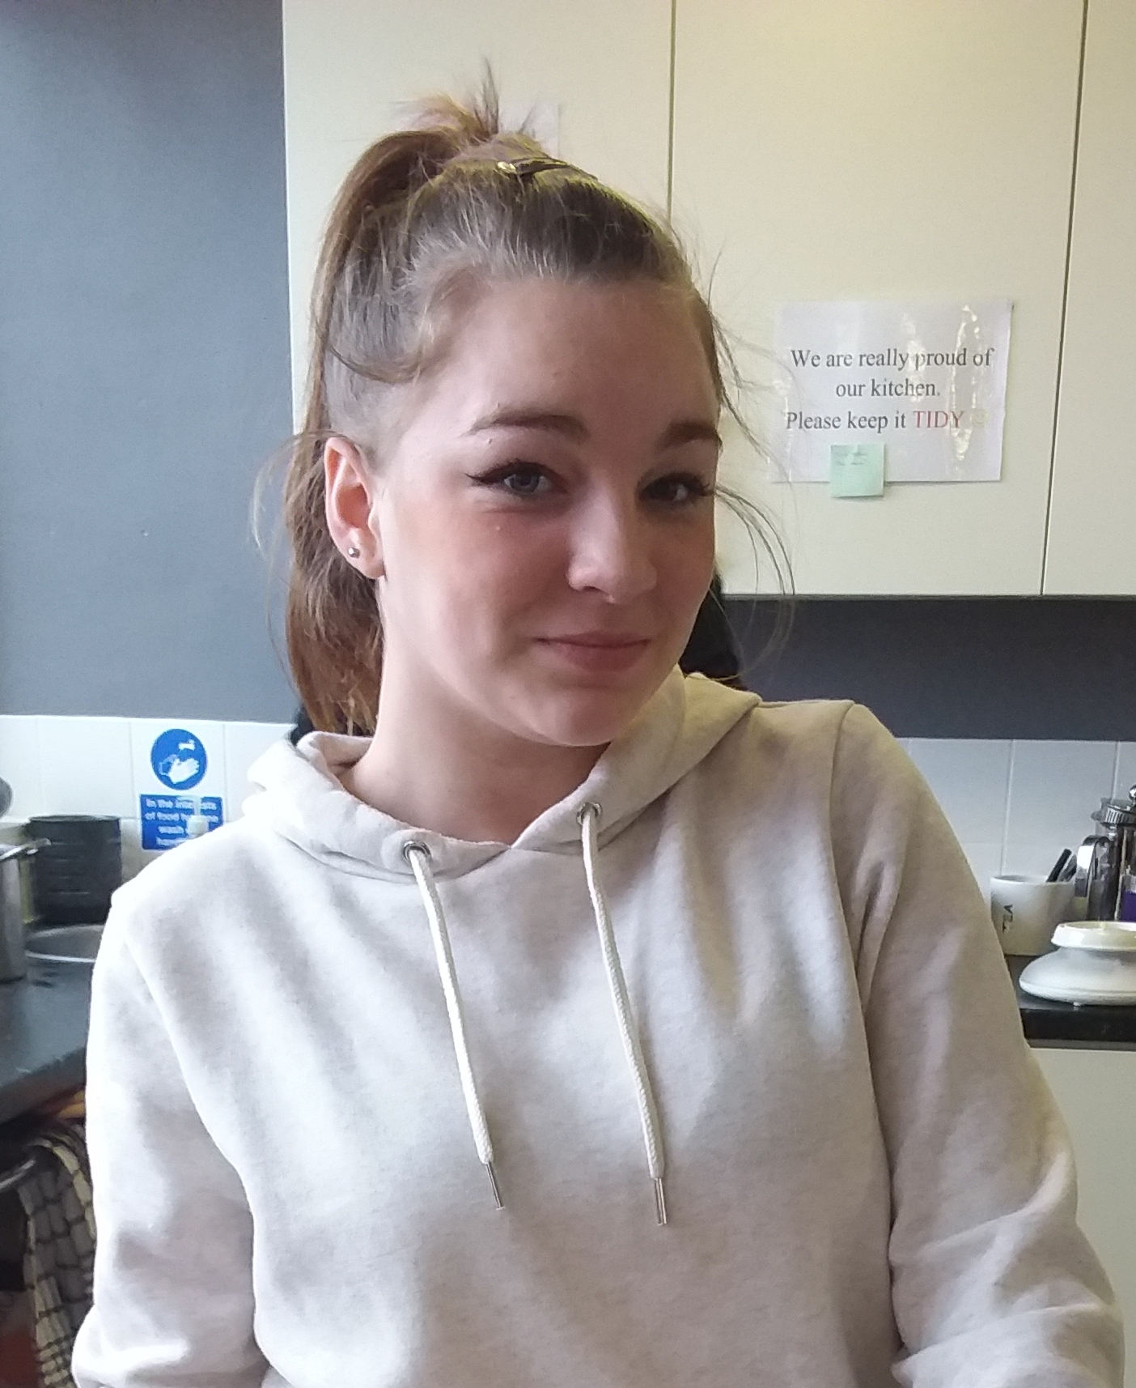
‘I’m a L2 Rep because I saw a poster about it and I liked the sound of it’

Slide 3
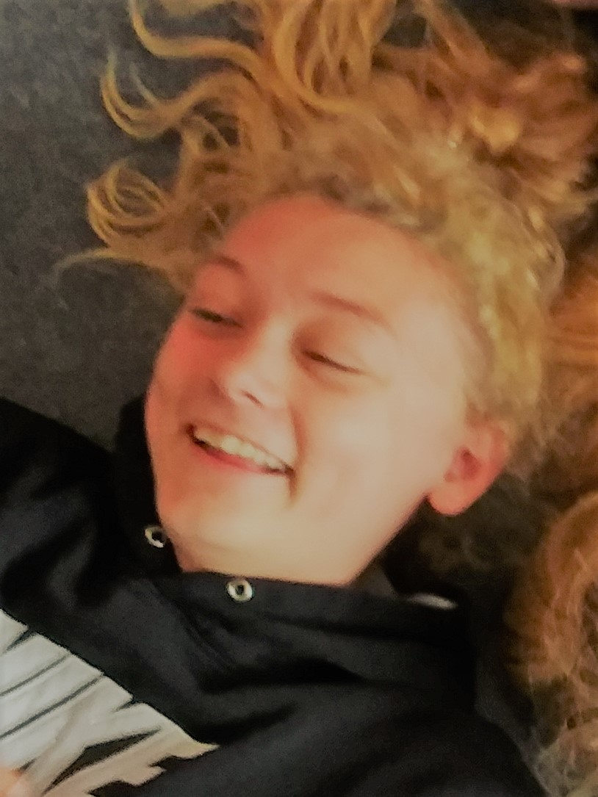
‘I’m a L2 Rep because I went to a rep breakfast in October and I like the sound of what it involves’

Slide 4
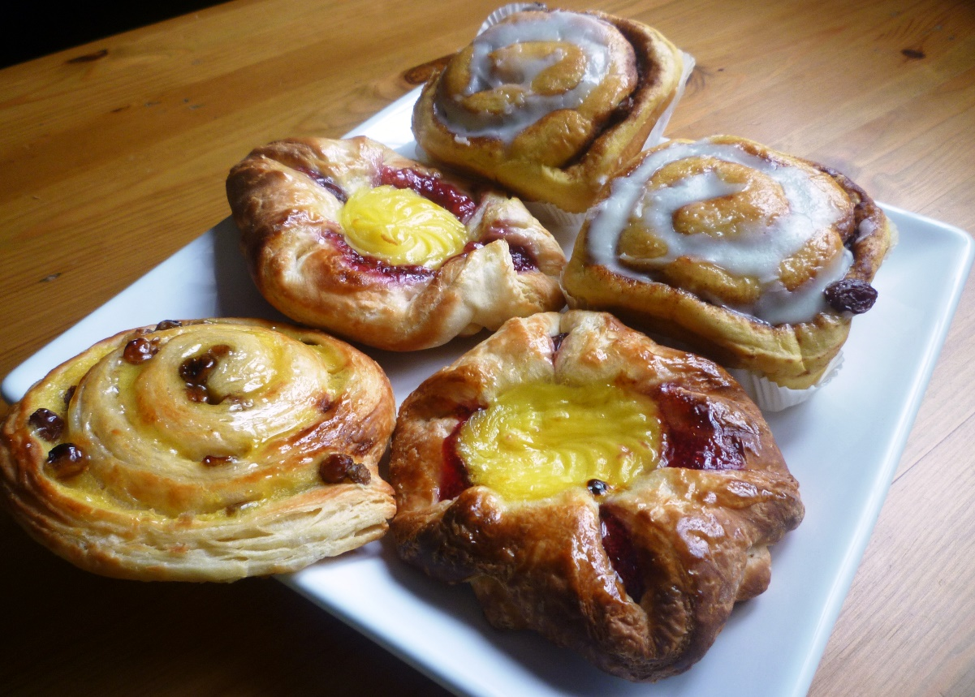
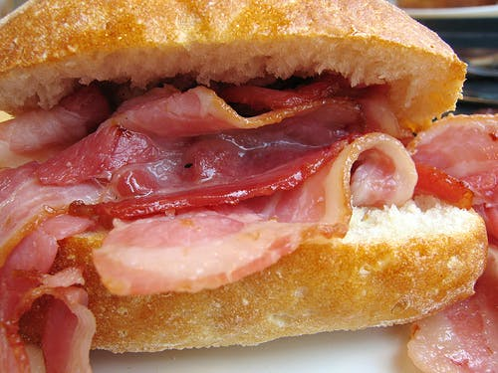
We wanted our next meeting as soon as possible because we enjoyed the rep breakfast so much!

Slide 5
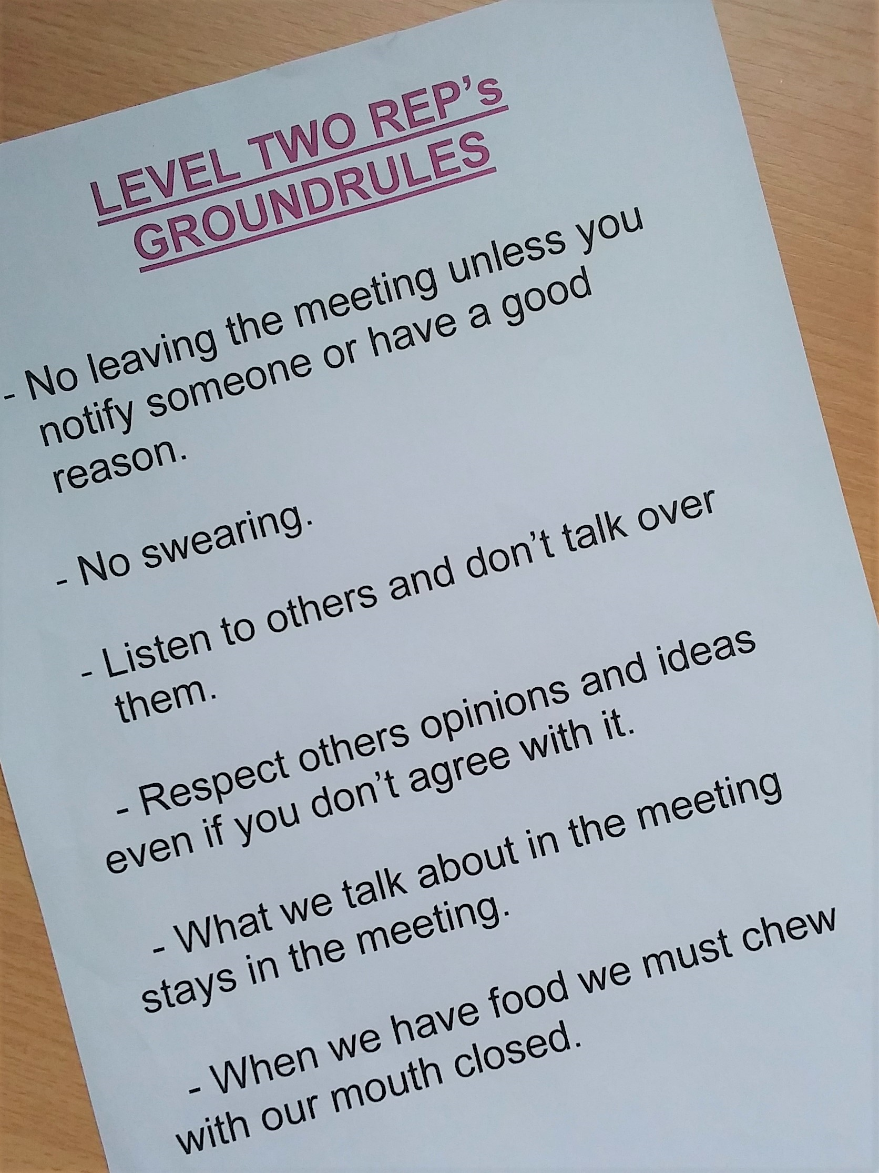
We agreed on some ground
rules for our meetings…

Slide 6
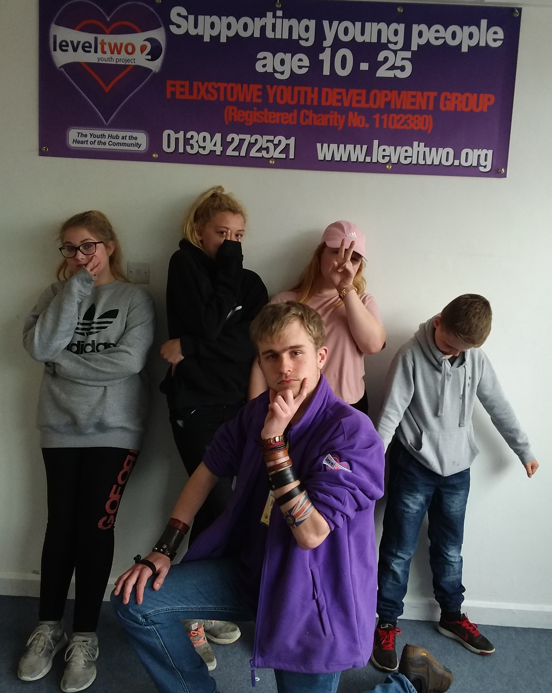
We have meetings every 3 weeks.
We come up here, have food and talk about Level Two.

Slide 7
We talk to young people in our sessions about ideas and get their feedback.
Then we have an input into decisions made at Level Two

Slide 8
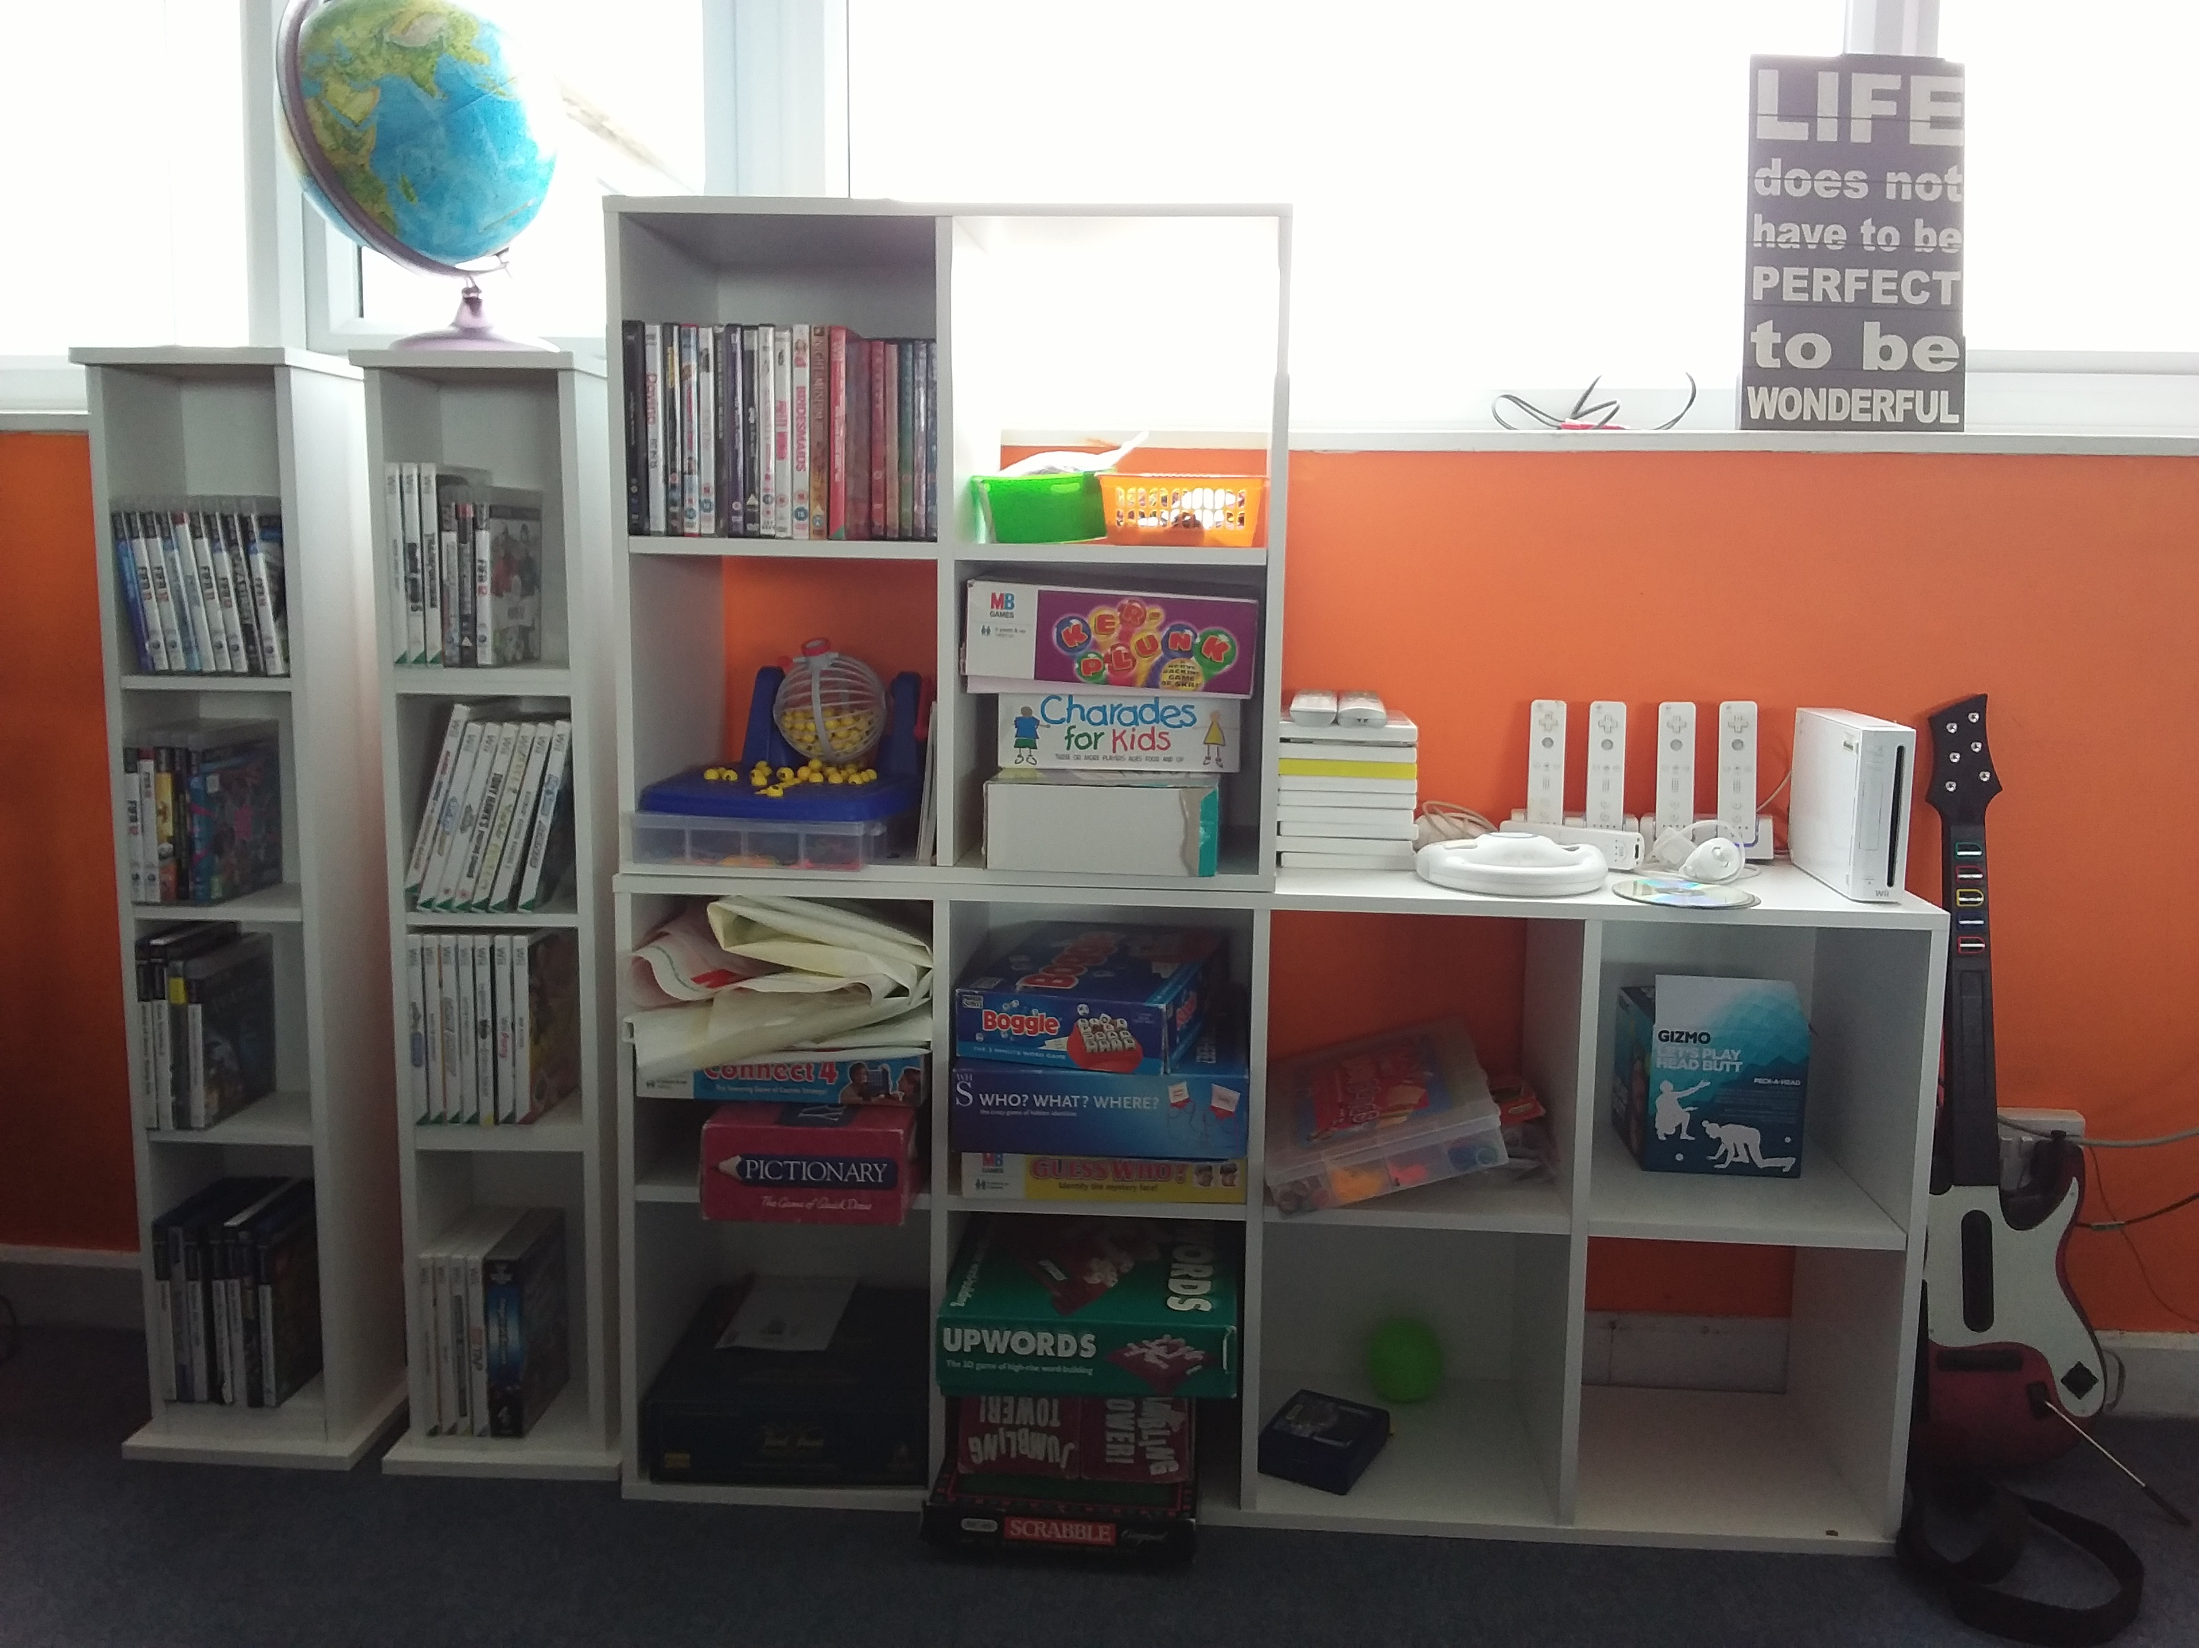
We’ve helped at The Mayor’s Ball, chosen new furniture, organised activities for open sessions and taken feedback to Felixstowe Youth Forum.

Slide 9
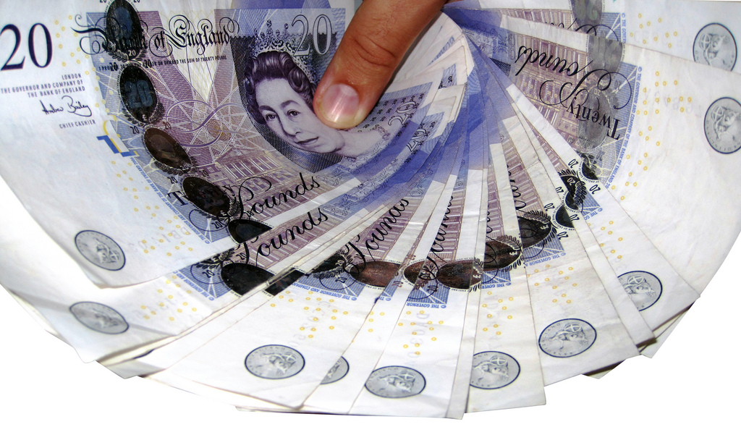
We are very grateful to the management board who have given us a £1000 budget!!

Slide 10
So, we are asking all young people for ideas on how best to use this money to benefit as many of us as possible.

Slide 11
We went to a Suffolk Assembly of Youth meeting in December. We told other youth organisations what we’re doing….

Slide 12
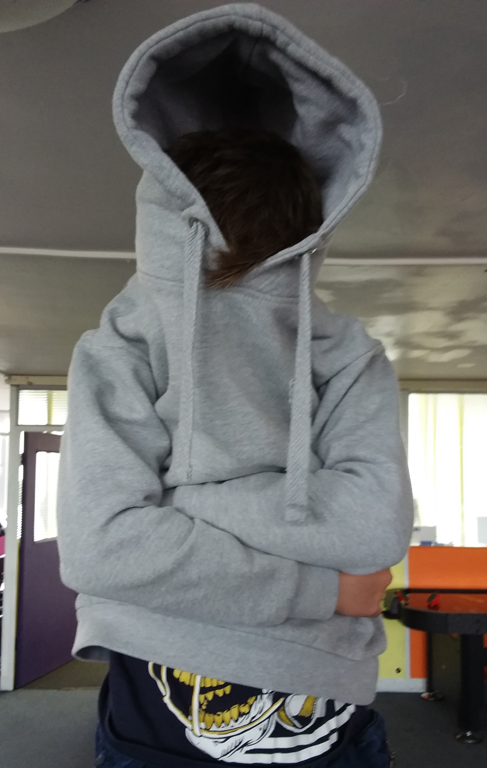
…and we gave our opinion on why participation of young people is so important.

Slide 13
We hope to meet again with other youth organisations across Suffolk to find out what they’re doing too!

Slide 14
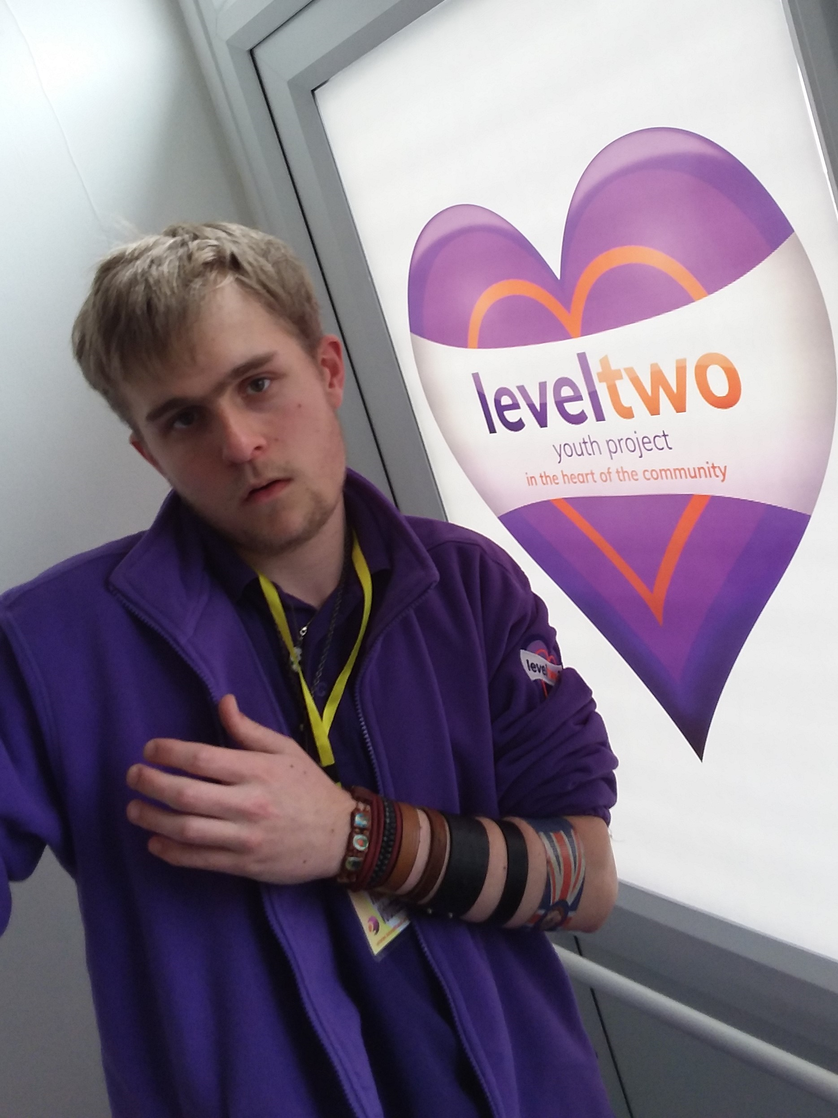
We think it’s good to meet other youth organisations so we can all share our experience and ideas

Slide 15
Quote from Kirsty Coldwell, Youth Worker:
“Tonight myself and 3 young people (one refused join in our crazy selfie) went to the SAY event. I am beyond proud of our young people.
Not only did they present very well…

Slide 16
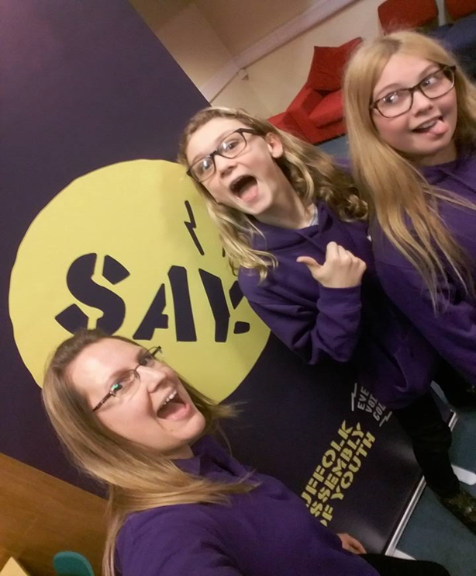
…but their passion shone through too.
Working with the reps is brilliant!
I feel very privileged to work with so many amazing young individuals.”

Slide 17
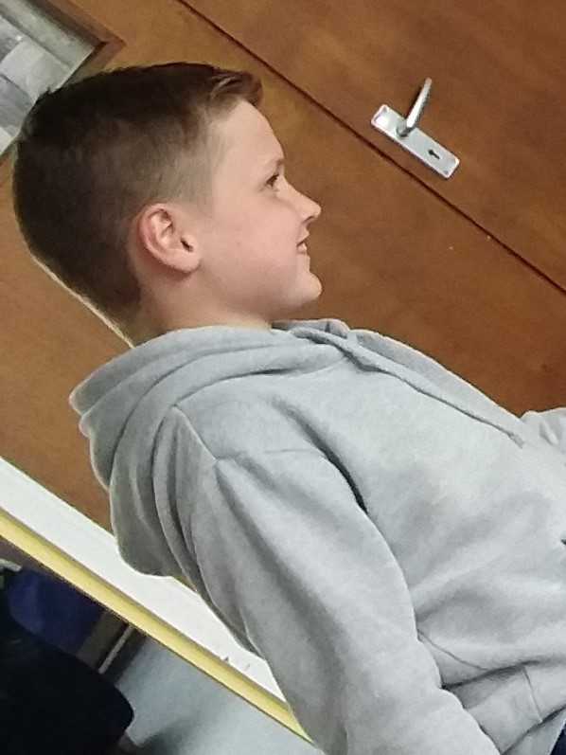
My favourite thing about being a rep is being able to have a ‘say’ in the place I come to
(Charlie, Year 7)

Slide 18
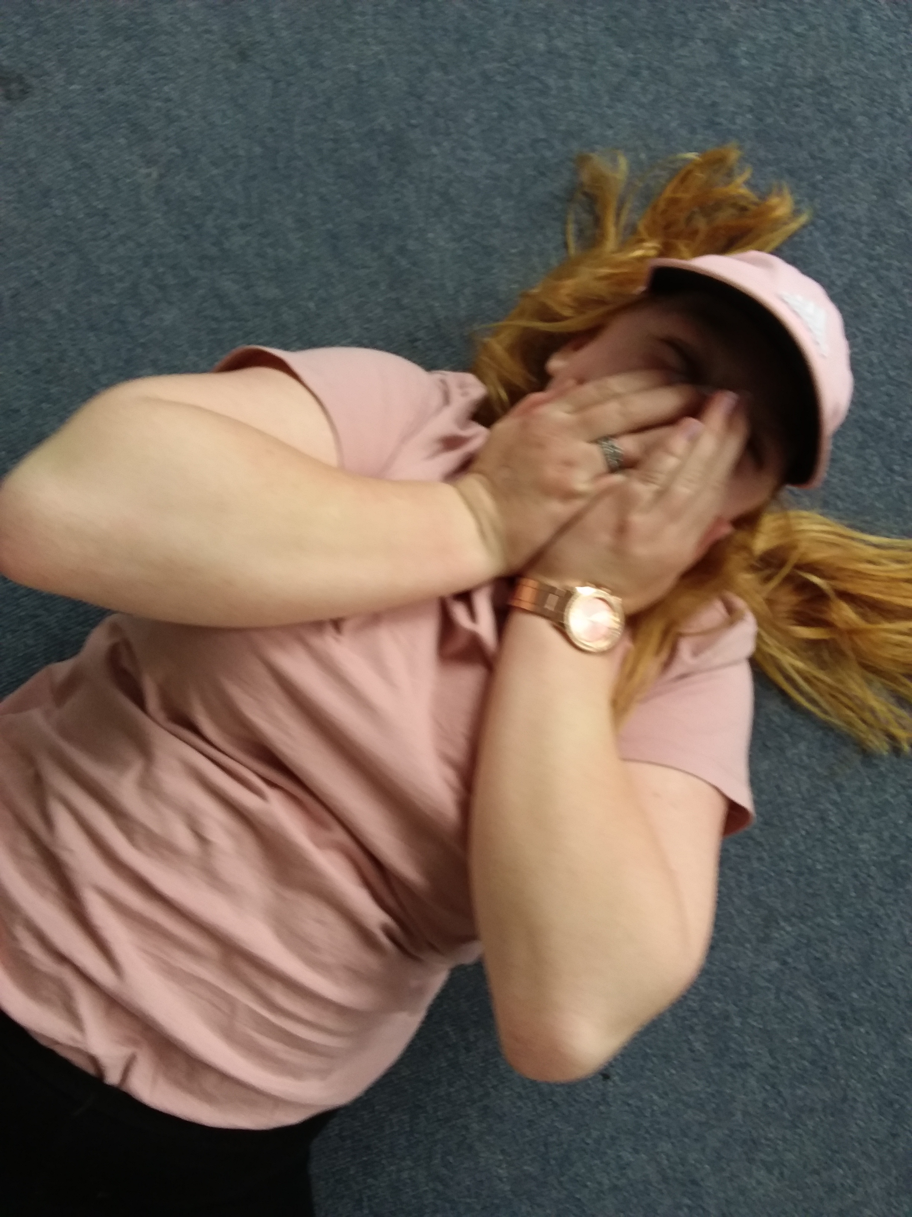
‘I’ve gained confidence speaking in public’ (Elise)

Slide 19
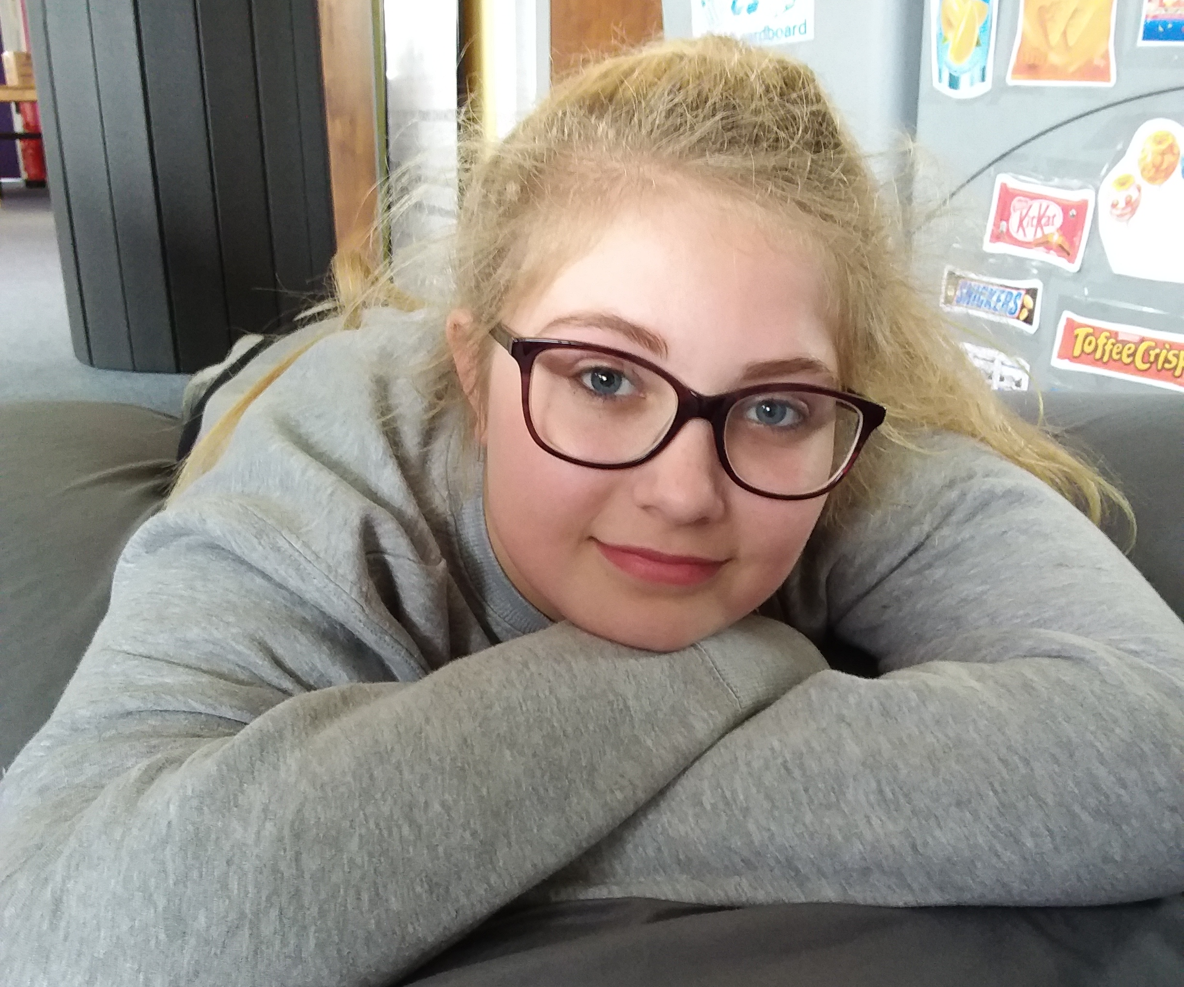
‘I feel less uncomfortable in situations where I don’t know people, and I am able to make conversation.’ (Chloe)

Slide 20
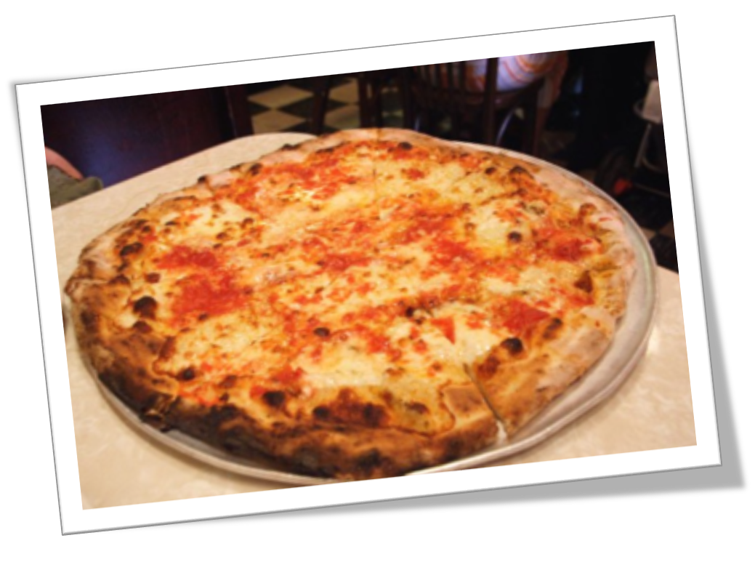
‘I can talk to the other reps about stuff too. We all support each other...
and there’s always food…’

Slide 21
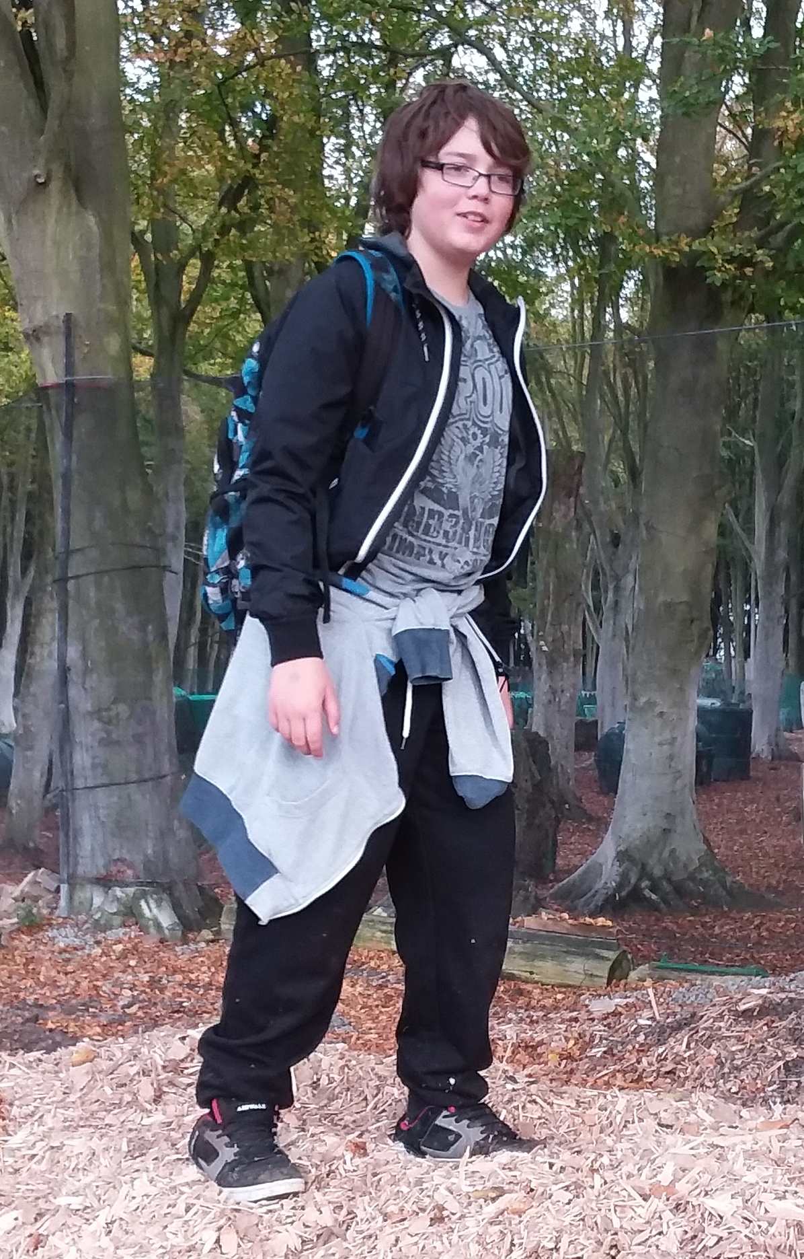
‘It’s been really good having a say in what’s happens at Level Two because we are able to make things happen.’

Slide 22
It’s really important for young people to have a say in the future of Level Two because….

Slide 23
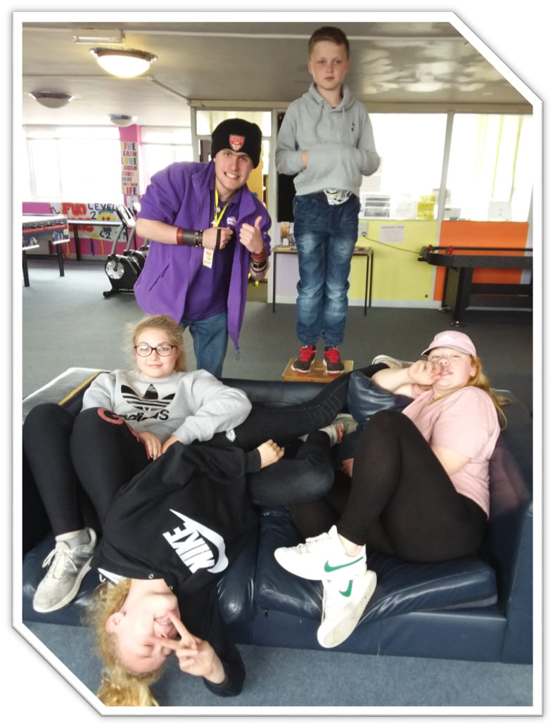
YOUNG PEOPLE ARE THE FUTURE
OF LEVEL TWO!!

